Slide 1




Project
Proposal

Slide 2


Introduction

Slide 3


The Netflix dataset includes information on movies and TV shows available on the platform, such as title, type (movie or TV show), director, cast, and country of production.
It also contains details like the date added to Netflix, release year, rating, duration, and genre.
The dataset is segmented into two distinct subsets: TV Shows and Movies, based on the 'type' column.
It provides a comprehensive view of Netflix's content landscape, allowing for trend analysis, country analysis, genre distribution, and rating insights.
The dataset can be used for various analyses, including understanding growth patterns, preferences, and trends over the years.

Slide 4
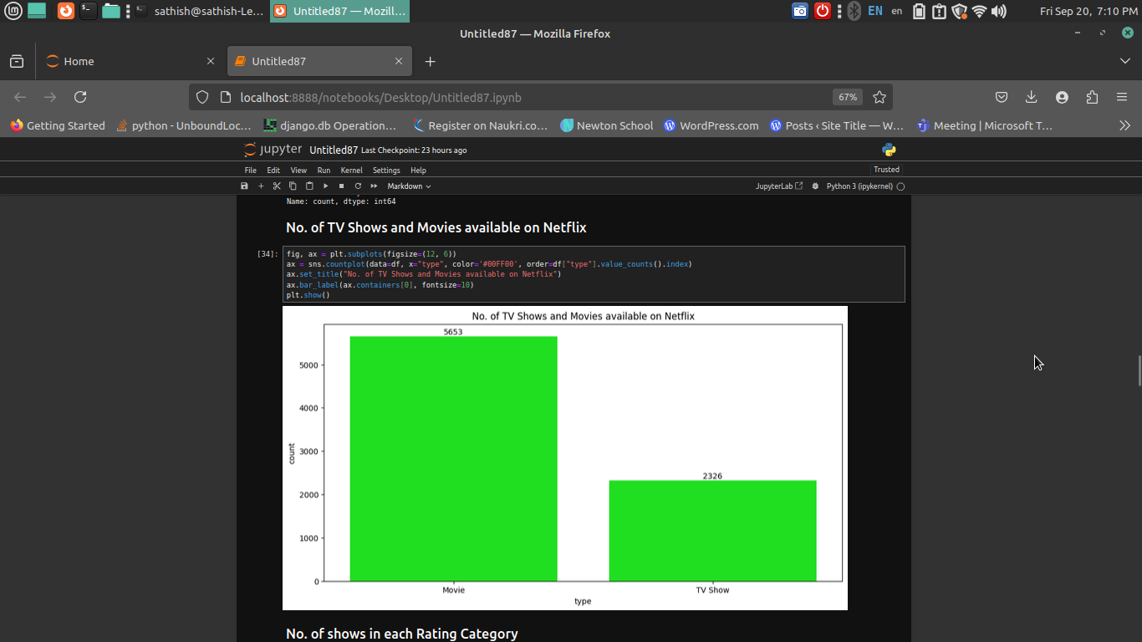
NO.OF TV Shows and Movies
currently available for Netflix movie 5653 and
TV shows 2326

Slide 5


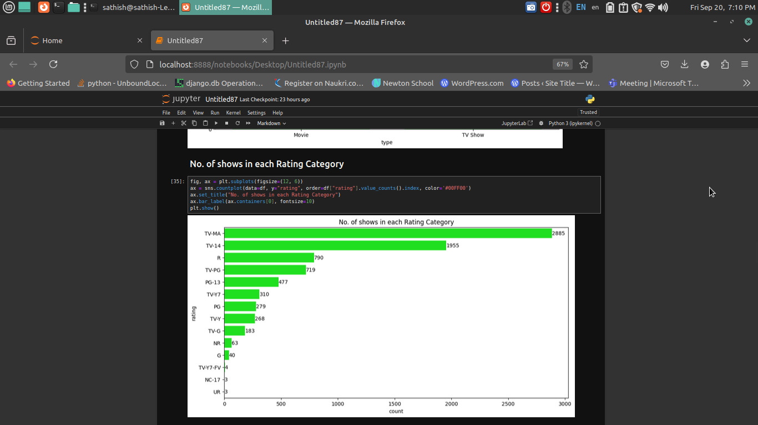


NO.OF TV In Each Rating Category
A chart shows the number of TV shows by rating, with TV-MA leading at 2885 shows, followed by TV-14 at 1955, R at 790, TV-PG at 749, and PG-13 at 477.

Slide 6
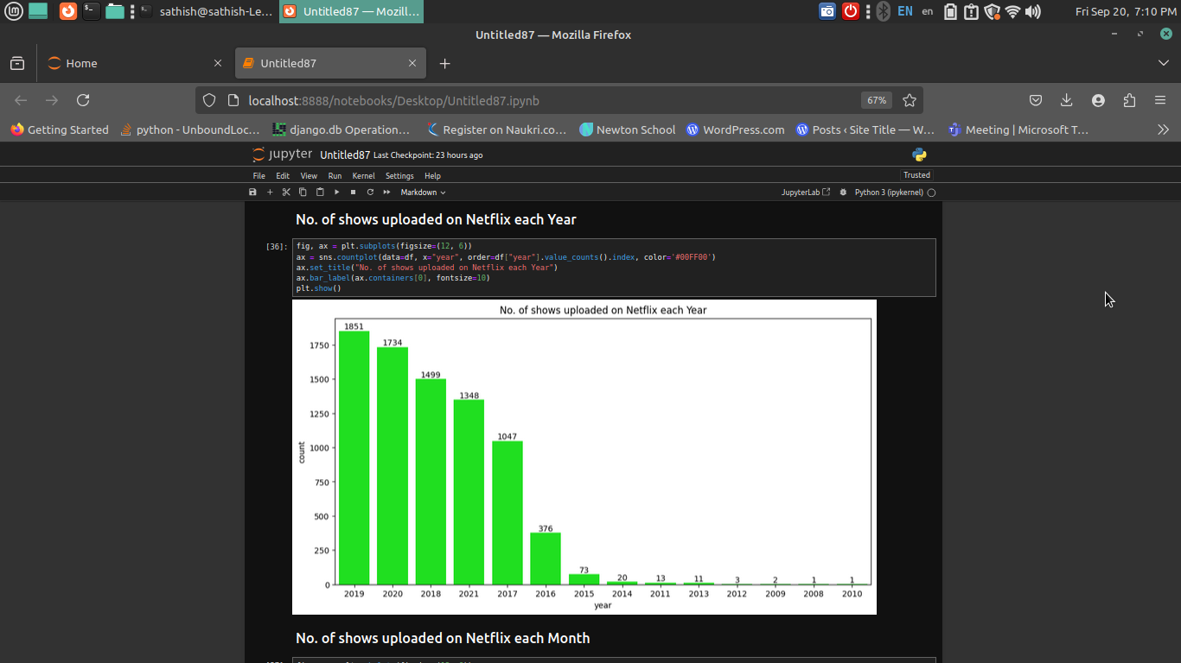
showing the number of movies and TV shows uploaded to Netflix each year from 2008 to 2021

Slide 7
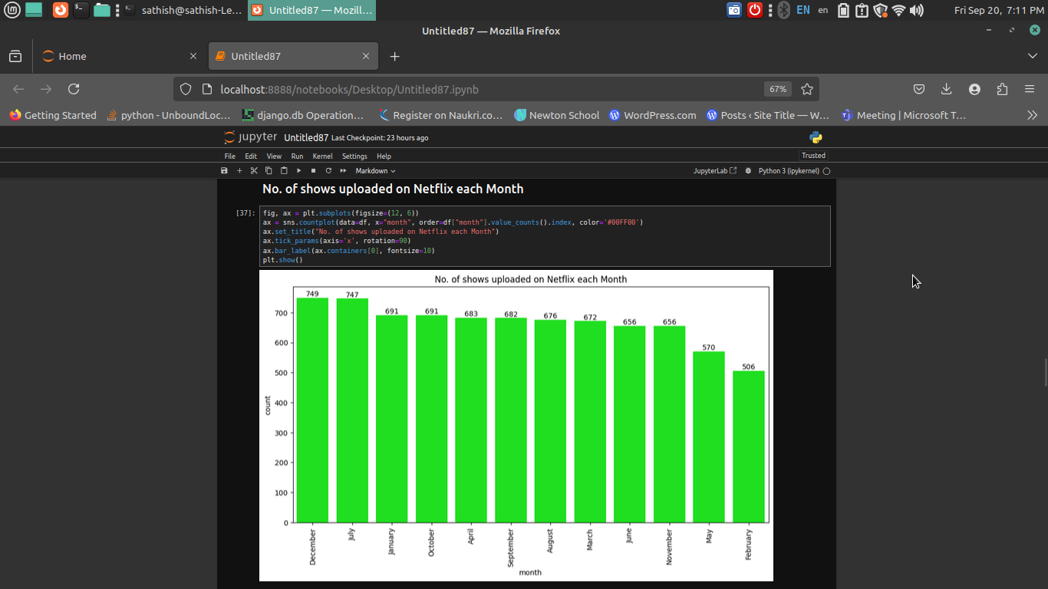


showing the number of movies and TV shows uploaded to Netflix each Month from 2008 to 2021

Slide 8
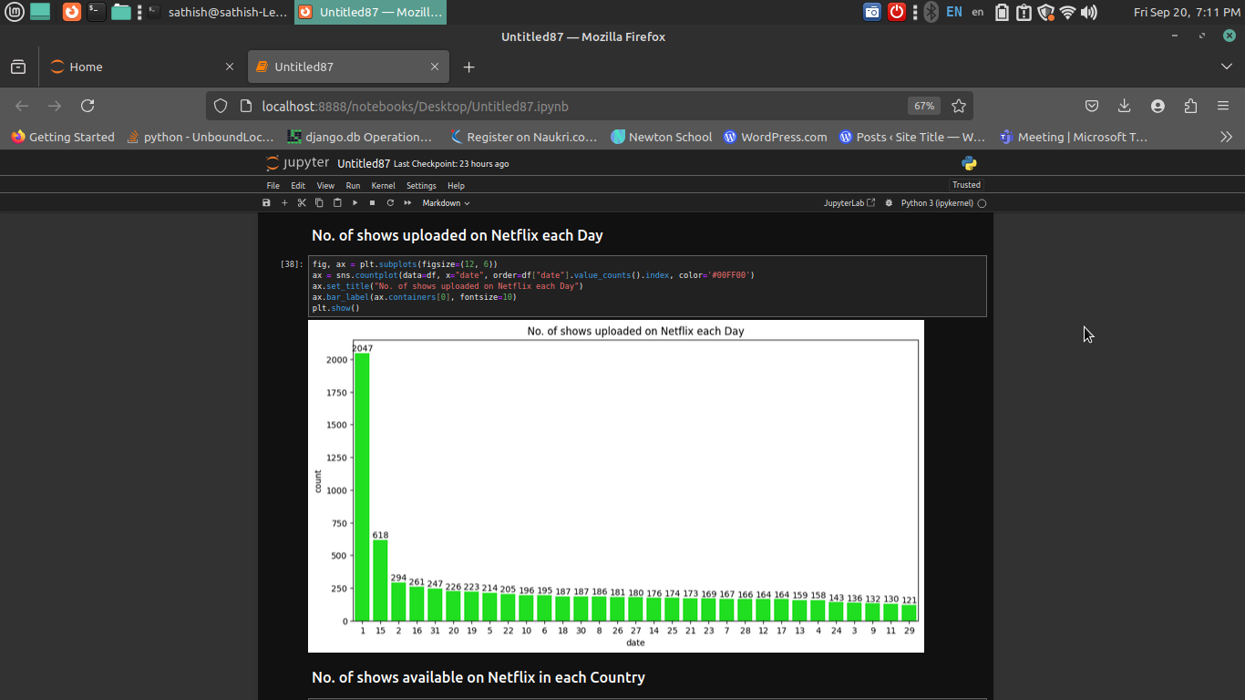
A chart shows the number of TV shows Upload On Each Month, with Day 1 leading at 2047 shows, followed by 15 at 618, 2 at 294

Slide 9

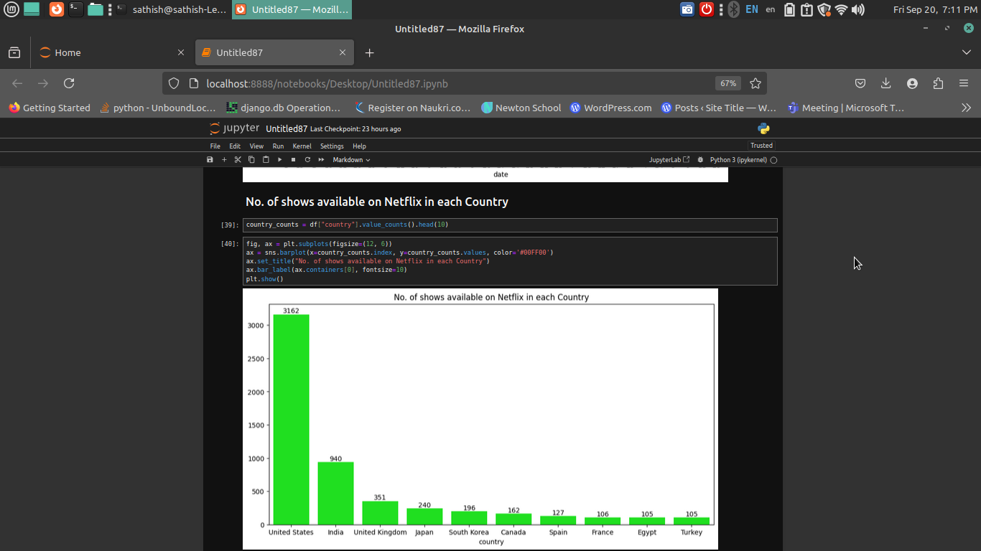
A chart shows that the United States has the most Netflix titles available at 3162, followed by India with 940 titles, and the United Kingdom with 351 titles."

Slide 10
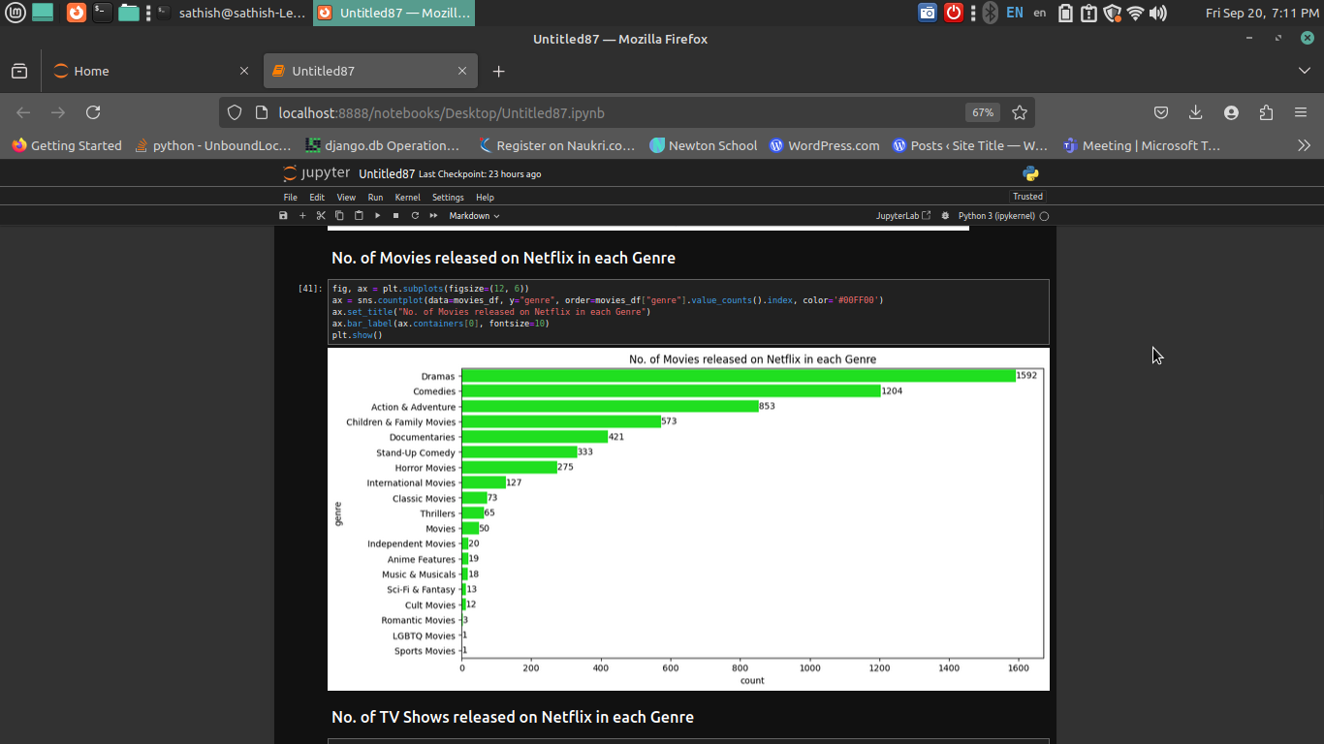
A chart shows the number of movies on Netflix by genre, with Drama leading at 1592 movies, followed by Comedy at 1204, Action & Adventure at 853, Children & Family movies at 573, and Documentaries at 421

Slide 11
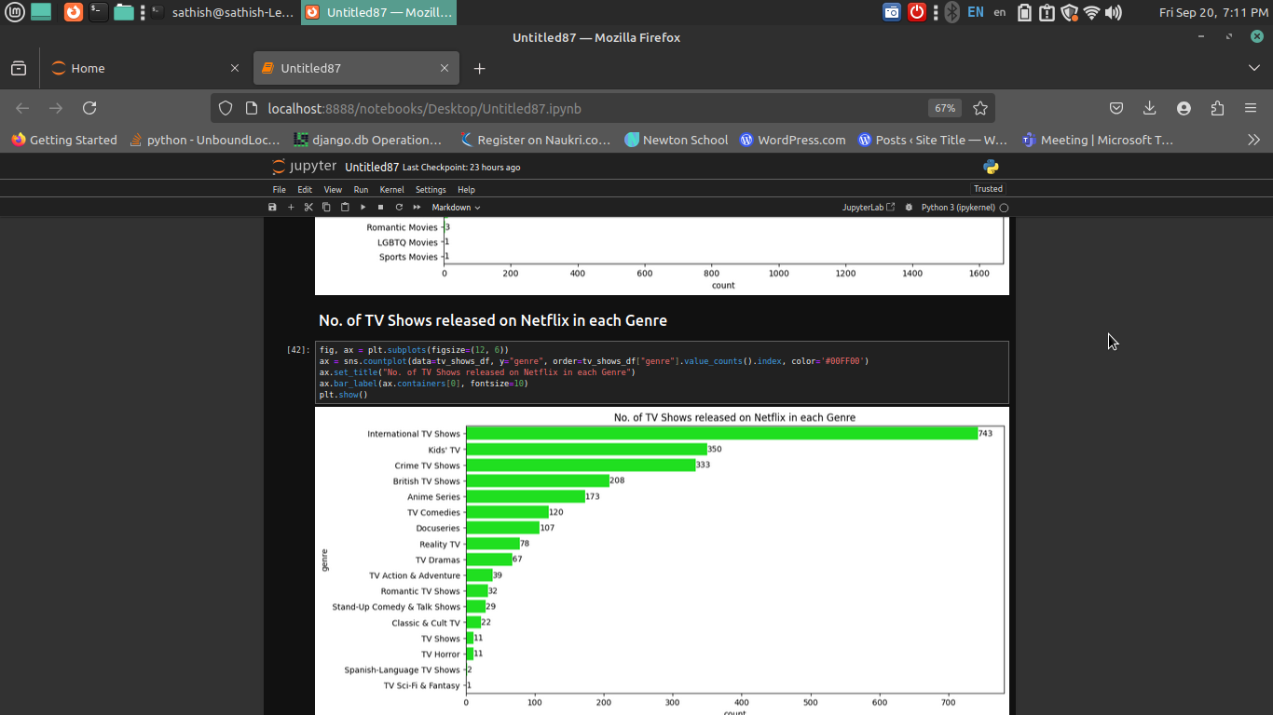
A chart shows the number of TV shows released on Netflix by genre, with International TV Shows leading at 743, followed by Kids TV at 350, Crime TV Shows at 333, British TV Shows at 208, and Anime Series at 173.

Slide 12

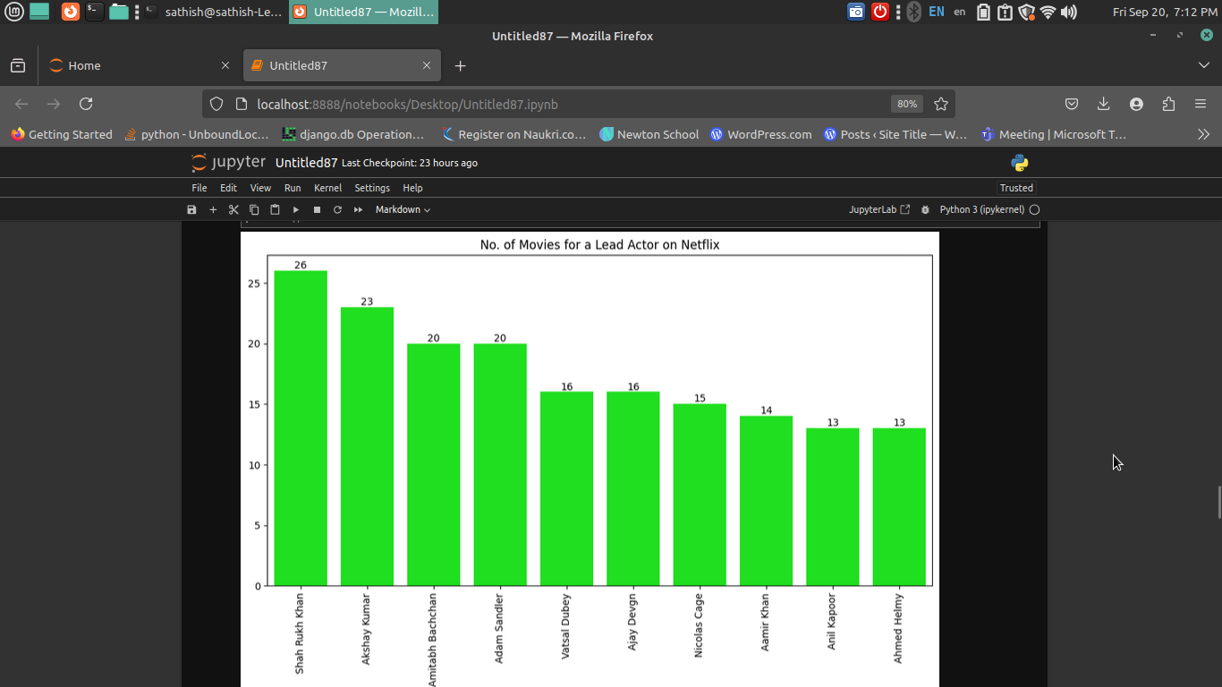
A chart shows the number of movies on Netflix led by top actors, with Shah Rukh Khan leading at 26 movies, followed by Akshay Kumar at 23, Amitabh Bachchan at 20, Adam Sandler also at 20, and
Vatsal Dubey at 16.

Slide 13
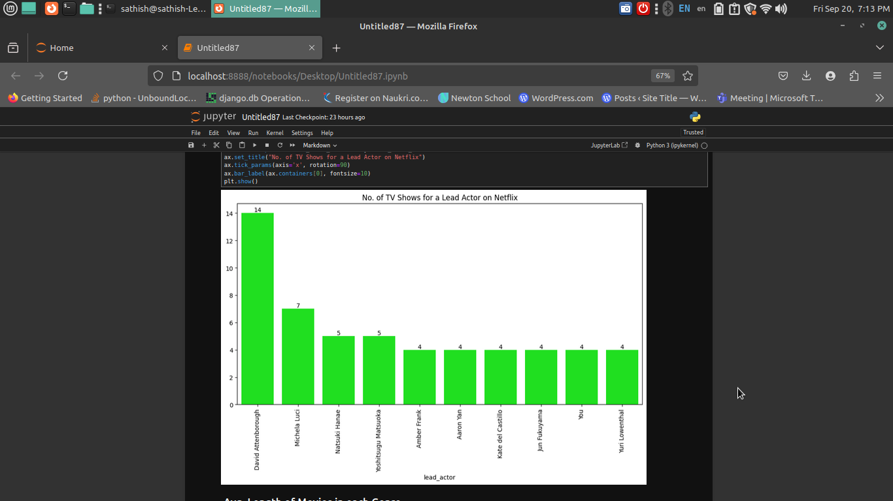
A chart shows the number of TV shows led by top actors on Netflix, with David Attenborough leading at 14 shows, followed by Michela Luci at 7, Natsuki Hanae and Yoshitsugu Matsuoka each at 5, and Amber Frank at 4.

Slide 14
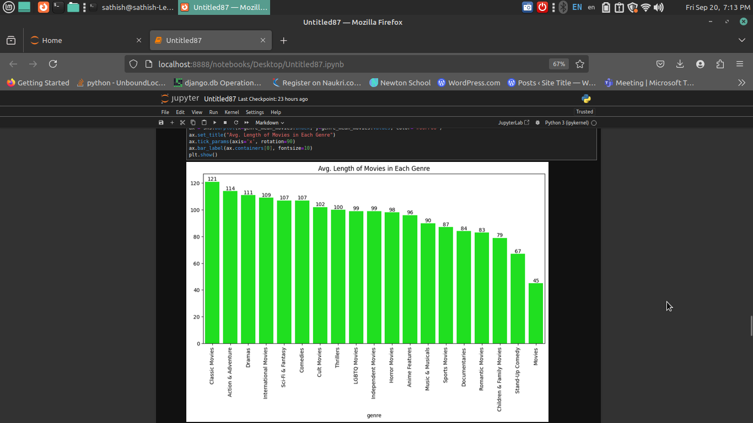
AVg Length of Movies in Each Genre
Classic Movies: 121 minutes
Action & Adventure: 114 minutes
Dramas: 111 minutes
International Movies: 109 minutes
Sci-Fi & Fantasy: 107 minutes

Slide 15
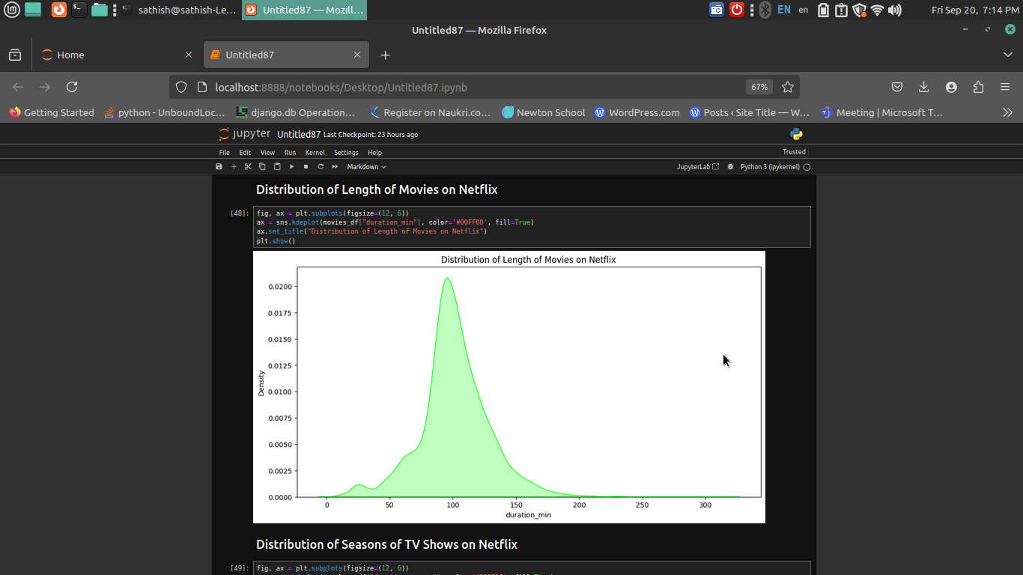
The distribution of movie lengths on Netflix shows that the average length is around 100 minutes, with most feature films falling within the 90-120 minute range, although there is variability with some genres and types of films, such as documentaries and indie movies, often being shorter.

Slide 16

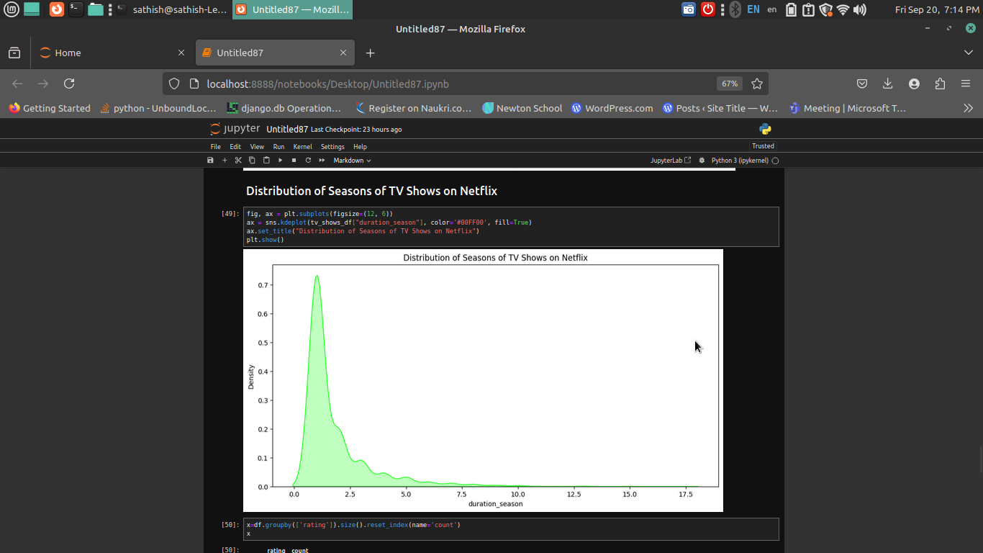
The distribution of TV show seasons on Netflix typically ranges from 1 to 2 seasons for many original series, with Netflix often ordering two seasons upfront for new projects, although some successful shows can extend to multiple seasons, reflecting a strategy that balances initial commitment with the potential for long-term engagement.

Slide 17

Thank
you

